Slide 1
Software process models
ISE 2019

Slide 2
There are many software processes but all must include four activities that are fundamental to software engineering:
SOFTWARE SPECIFICATION: The functionality of the software and constraints on its operation must be defined.
SOFTWARE SPECIFICATION & IMPLEMENTATION: The software to meet the specification must be provided.
SOFTWARE VALIDATION: The software must be validated to ensure that it does what the customer wants.
SOFTWARE EVOLUTION: The software must evolve to meet changing customer needs.

Slide 3
Software process models
The waterfall model
Plan-driven model. Separate and distinct phases of specification and development.
Incremental development
This approach interleaves the activities of specification, development and validation . The system is developed as a series of versions (increments) with each version adding functionality to the previous version.
Reuse oriented software engineering
The system is assembled from existing configurable components. Focuses on integrating these components into a system rather than developing from scratch.
In practice, most large systems are developed using a process that incorporates elements from all of these models.

Slide 4
The waterfall model

Slide 5
Waterfall model phases
There are separate identified phases in the waterfall model:
Requirements analysis and definition
System and software design
Implementation and unit testing
Integration and system testing
Operation and maintenance
The main drawback of the waterfall model is the difficulty of accommodating change after the process is underway. In principle, a phase has to be complete before moving onto the next phase.

Slide 6
Waterfall model phases
The principal stages of the waterfall model directly reflect the fundamental development
activities:
1. Requirements analysis and definition The system’s services, constraints, and goals are established by consultation with system users. They are then defined in detail and serve as a system specification.
2. System and software design The systems design process allocates the requirements to either hardware or software systems by establishing an overall system
architecture. Software design involves identifying and describing the fundamental software system abstractions and their relationships.

Slide 7
Waterfall model phases
3.Implementation and unit testing During this stage, the software design is realized as a set of programs or program units. Unit testing involves verifying that each unit meets its specification.
4. Integration and system testing The individual program units or programs are integrated and tested as a complete system to ensure that the software requirements have been met. After testing, the software system is delivered to the customer.
5. Operation and maintenance this is the longest life cycle phase. The system is installed and put into practical use. Maintenance involves correcting errors which were not discovered in earlier stages of the life cycle, improving the implementation of system units and enhancing the system’s services as new requirements are discovered.

Slide 8
Waterfall model problems
Inflexible partitioning of the project into distinct stages makes it difficult to respond to changing customer requirements.
Therefore, this model is only appropriate when the requirements are well-understood and changes will be fairly limited during the design process.
Few business systems have stable requirements.
The waterfall model is mostly used for large systems engineering projects where a system is developed at several sites.
In those circumstances, the plan-driven nature of the waterfall model helps coordinate the work.

Slide 9
Incremental development

Slide 10
Incremental development
Incremental development is based on the idea of developing an initial implementation, exposing this to user comment and evolving it through several versions until an adequate system has been developed (Figure). Specification, development, and validation activities are interleaved rather than separate, with rapid feedback across activities.
Incremental development reflects the way that we solve problems, rarely work out a complete problem solution in advance but move toward a solution in a series of steps, backtracking when we realize that we have made a mistake. By developing the software incrementally, it is cheaper and easier to make changes in the software as it is being developed.

Slide 11
Incremental development
Each increment or version of the system incorporates some of the functionality that is needed by the customer. Generally, the early increments of the system include the most important or most urgently required functionality. This means that the customer can evaluate the system at a relatively early stage in the development to see if it delivers what is required. If not, then only the current increment has to be changed and, possibly, new functionality defined for later increments.

Slide 12
The Incremental Model
•Software separated into different “increments”
-complete working portions
•Focus on delivery of operational product with
each increment -can be evaluated
•Useful when insufficient staff and can be planned to manage technical risks,
e.g. waiting for new hardware

Slide 13
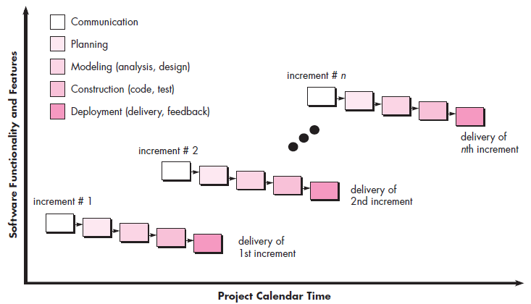
The Incremental Model

Slide 14
Incremental development benefits
The cost of accommodating changing customer requirements is reduced.
The amount of analysis and documentation that has to be redone is much less than is required with the waterfall model.
It is easier to get customer feedback on the development work that has been done.
Customers can comment on demonstrations of the software and see how much has been implemented.
More rapid delivery and deployment of useful software to the customer is possible.
Customers are able to use and gain value from the software earlier than is possible with a waterfall process.

Slide 15
Incremental development problems
The process is not visible.
Managers need regular deliverables to measure progress. If systems are developed quickly, it is not cost-effective to produce documents that reflect every version of the system.
System structure tends to degrade as new increments are added.
Unless time and money is spent on refactoring to improve the software, regular change tends to corrupt its structure. Incorporating further software changes becomes increasingly difficult and costly

Slide 16

Reuse-oriented software engineering

Slide 17
Reuse-oriented software engineering
Based on systematic reuse where systems are integrated from existing components or COTS (Commercial-off-the-shelf) systems.
Process stages
Component analysis;
Requirements modification;
System design with reuse;
Development and integration.
Reuse is now the standard approach for building many types of business system

Slide 18
Reuse-oriented software engineering
In the majority of software projects, there is some software reuse. This often happens informally when people working on the project know of designs or code that are similar to what is required. They look for these, modify them as needed, and incorporate them into their system.

Slide 19
Reuse-oriented software engineering
1.Component analysis Given the requirements specification, a search is made for components to implement that specification. Usually, there is no exact match and the components that may be used only provide some of the functionality required.
2. Requirements modification During this stage, the requirements are analyzed using information about the components that have been discovered. They are then modified to reflect the available components. Where modifications are impossible, the component analysis activity may be re-entered to search for alternative solutions.

Slide 20
Reuse-oriented software engineering
3.System design with reuse During this phase, the framework of the system is designed or an existing framework is reused. The designers take into account the components that are reused and organize the framework to cater for this. Some new software may have to be designed if reusable components are not available.
4. Development and integration Software that cannot be externally procured is developed, and the components and COTS systems are integrated to create the new system. System integration, in this model, may be part of the development process rather than a separate activity

Slide 21
Reuse-oriented software engineering
There are three types of software component that may be used in a reuse-oriented process:
1. Web services that are developed according to service standards and which are available for remote invocation.
2. Collections of objects that are developed as a package to be integrated with a component framework such as .NET or J2EE.
3. Stand-alone software systems that are configured for use in a particular environment.

Slide 22
Process activities
Real software processes are inter-leaved sequences of technical, collaborative and managerial activities with the overall goal of specifying, designing, implementing and testing a software system.
The four basic process activities of specification, development, validation and evolution are organized differently in different development processes. In the waterfall model, they are organized in sequence, whereas in incremental development they are inter-leaved.

Slide 23
Software specification
Software specification or requirements engineering is the process of understanding and defining what services are required from the system and identifying the constraints on the system’s operation and development. Requirements engineering is a particularly critical stage of the software process as errors at this stage inevitably lead to later problems in the system design and implementation.
Requirements engineering process
Feasibility study
Is it technically and financially feasible to build the system?
Requirements elicitation and analysis
What do the system stakeholders require or expect from the system?
Requirements specification
Defining the requirements in detail
Requirements validation
Checking the validity of the requirements

Slide 24
Software specification
There are four main activities in the requirements engineering process:
1. Feasibility study An estimate is made of whether the identified user needs may be satisfied using current software and hardware technologies. The study considers whether the proposed system will be cost-effective from a business point of view and if it can be developed within existing budgetary constraints. A feasibility study should be relatively cheap and quick. The result should inform the decision of whether or not to go ahead with a more detailed analysis.
2. Requirements elicitation and analysis This is the process of deriving the system requirements through observation of existing systems, discussions with potential users and procurers, task analysis, and so on. This may involve the development of one or more system models and prototypes. These help you understand the system to be specified.

Slide 25
Software specification
3. Requirements specification Requirements specification is the activity of translating the information gathered during the analysis activity into a document that defines a set of requirements. Two types of requirements may be included in this document. User requirements are abstract statements of the system requirements for the customer and end-user of the system; system requirements are a more detailed description of the functionality to be provided.
4. Requirements validation This activity checks the requirements for realism, consistency, and completeness. During this process, errors in the requirements document are inevitably discovered. It must then be modified to correct these problems.

Slide 26
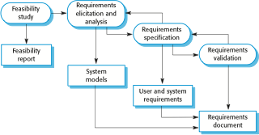
Software specification

Slide 27
Software design and implementation
The process of converting the system specification into an executable system.
Software design
Design a software structure that realises the specification;
Implementation
Translate this structure into an executable program;
The activities of design and implementation are closely related and may be inter-leaved.

Slide 28
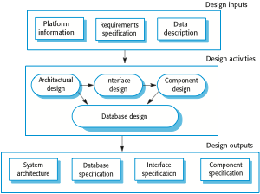
Software design and implementation

Slide 29
Software design and implementation
The implementation stage of software development is the process of converting a system specification into an executable system.
A software design is a description of the structure of the software to be implemented, the data models and structures used by the system, the interfaces between system components and, sometimes, the algorithms used.
Designers do not arrive at a finished design immediately but develop the design iteratively. They add formality and detail as they develop their design with constant backtracking to correct earlier designs.

Slide 30
Software design and implementation
1. Most software interfaces with other software systems. These include the operating system, database, middleware, and other application systems. These make up the ‘software platform’, the environment in which the software will execute. Information about this platform is an essential input to the design process, as designers must decide how best to integrate it with the software’s environment.
2. The activities in the design process vary, depending on the type of system being developed.
Four activities that may be part of the design process for information systems:

Slide 31
Software design and implementation
1. Architectural design, where you identify the overall structure of the system, the principal components (sometimes called sub-systems or modules), their relationships, and how they are distributed.
2. Interface design, where you define the interfaces between system components. With a precise interface, a component can be used without other components having to know how it is implemented. Once interface specifications are agreed, the components can be designed and developed concurrently.

Slide 32
Software design and implementation
Component design, where you take each system component and design how it will operate.
Database design, where you design the system data structures and how these are to be represented in a database.

Slide 33
Software validation
Verification and validation (V & V) is intended to show that a system conforms to its specification and meets the requirements of the system customer.
Involves checking and review processes and system testing.
System testing involves executing the system with test cases that are derived from the specification of the real data to be processed by the system.
Testing is the most commonly used V & V activity.

Slide 34

Stages of testing

Slide 35
Testing stages
Development or component testing
Individual components are tested independently;
Components may be functions or objects or coherent groupings of these entities.
System testing
Testing of the system as a whole. Testing of emergent properties is particularly important.
Acceptance testing
Testing with customer data to check that the system meets the customer’s needs.

Slide 36
When a plan-driven software process is used (e.g., for critical systems development),testing is driven by a set of test plans. An independent team of testers works from these pre-formulated test plans, which have been developed from the system specification and design. Figure 2.7 illustrates how test plans are the link between testing and development activities. This is sometimes called the V-model of development (turn it on its side to see the V).
Acceptance testing is sometimes called ‘alpha testing’. Custom systems are developed for a single client. The alpha testing process continues until the system developer and the client agree that the delivered system is an acceptable implementation of the requirements.
When a system is to be marketed as a software product, a testing process called ‘beta testing’ is often used. Beta testing involves delivering a system to a number of potential customers who agree to use that system. They report problems to the system developers. This exposes the product to real use and detects errors that may not have been anticipated by the system builders. After this feedback, the system is modified and released either for further beta testing or for general sale.

Slide 37
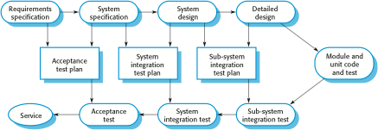

Slide 38
Software Evolution
The flexibility of software systems is one of the main reasons why more and more software is being incorporated in large, complex systems. Once a decision has been made to manufacture hardware, it is very expensive to make changes to the hardware design. However, changes can be made to software at any time during or after the system development. Even extensive changes are still much cheaper than corresponding changes to system hardware.
It is more realistic to think of software engineering as an evolutionary process where software is continually changed over its lifetime in response to changing requirements and customer needs.

Slide 39
Points to remember
Software processes are the activities involved in producing a software system. Software process models are abstract representations of these processes.
General process models describe the organization of software processes. Examples of these general models include the ‘waterfall’ model, incremental development, and reuse-oriented development.
Requirements engineering is the process of developing a software specification.

Slide 40
Points to remember
Design and implementation processes are concerned with transforming a requirements specification into an executable software system.
Software validation is the process of checking that the system conforms to its specification and that it meets the real needs of the users of the system.
Software evolution takes place when you change existing software systems to meet new requirements. The software must evolve to remain useful.

Slide 41
Coping with change
Change is inevitable in all large software projects. The system requirements change as the business procuring the system responds to external pressures and management priorities change. As new technologies become available, new design and implementation possibilities emerge. Therefore whatever software process model is used, it is essential that it can accommodate changes to the software being developed.
Change adds to the costs of software development because it usually means that work that has been completed has to be redone. This is called rework

Slide 42
Coping with change
Change is inevitable in all large software projects.
Business changes lead to new and changed system requirements
New technologies open up new possibilities for improving implementations
Changing platforms require application changes
Change leads to rework so the costs of change include both rework (e.g. re-analysing requirements) as well as the costs of implementing new functionality

Slide 43
Reducing the costs of rework
Change avoidance, where the software process includes activities that can anticipate possible changes before significant rework is required.
For example, a prototype system may be developed to show some key features of the system to customers. They can experiment with the prototype and refine their requirements before committing to high software production costs.
Change tolerance, where the process is designed so that changes can be accommodated at relatively low cost.
This normally involves some form of incremental development. Proposed changes may be implemented in increments that have not yet been developed. If this is impossible, then only a single increment (a small part of the system) may have be altered to incorporate the change.
Two types of coping with change and changing system requirements are:

Slide 44
Software prototyping
A prototype is an initial version of a system used to demonstrate concepts and try out design options. and find out more about the problem and its possible solutions. Rapid, iterative development of the prototype is essential so that costs are controlled and system stakeholders can experiment with the prototype early in the software process.
A prototype can be used in:
The requirements engineering process to help with requirements elicitation and validation;
In design processes to explore options and develop a UI design;
In the testing process to run back-to-back tests.

Slide 45
Benefits of prototyping
Improved system usability.
A closer match to users’ real needs.
Improved design quality.
Improved maintainability.
Reduced development effort.

Slide 46
The process of prototype development
System prototypes allow users to see how well the system supports their work. They may get new ideas for requirements, and find areas of strength and weakness in the software. They may then propose new system requirements. Furthermore, as the prototype is developed, it may reveal errors and omissions in the requirements that have been proposed.
A system prototype may be used while the system is being designed to carry out design experiments to check the feasibility of a proposed design. For example, a database design may be prototyped and tested to check that it supports efficient data access for the most common user queries. Prototyping is also an essential part of the user interface design process.

Slide 47

The process of prototype development

Slide 48
The process of prototype development
The objectives of prototyping should be made explicit from the start of the process. These may be to develop a system to prototype the user interface, to develop a system to validate functional system requirements, or to develop a system to demonstrate the feasibility of the application to managers. The same prototype cannot meet all objectives. If the objectives are left unstated, management or end-users may misunderstand the function of the prototype.
The next stage in the process is to decide what to put into and, perhaps more importantly, what to leave out of the prototype system. To reduce prototyping costs and accelerate the delivery schedule, you may leave some functionality out of the prototype. You may decide to relax non-functional requirements such as response time and memory utilization. Error handling and management may be ignored unless the objective of the prototype is to establish a user interface. Standards of reliability and program quality may be reduced.

Slide 49
The process of prototype development
The final stage of the process is prototype evaluation. Provision must be made during this stage for user training and the prototype objectives should be used to derive a plan for evaluation. Users need time to become comfortable with a new system and to settle into a normal pattern of usage. Once they are using the system normally,they then discover requirements errors and omissions.

Slide 50
Throw-away prototypes
Developers are sometimes pressured by managers to deliver throwaway prototypes, particularly when there are delays in delivering the final version of the software.
1. It may be impossible to tune the prototype to meet non-functional requirements, such as performance, security, robustness, and reliability requirements, which were ignored during prototype development.

Slide 51
Throw-away prototypes
2. Rapid change during development inevitably means that the prototype is undocumented. The only design specification is the prototype code. This is not good enough for long-term maintenance.
3. The changes made during prototype development will probably have degraded the system structure. The system will be difficult and expensive to maintain.
4. Organizational quality standards are normally relaxed for prototype development.

Slide 52
Incremental delivery
Rather than deliver the system as a single delivery, the development and delivery is broken down into increments with each increment delivering part of the required functionality.
User requirements are prioritised and the highest priority requirements are included in early increments.
Once the system increments have been identified, the requirements for the services to be delivered in the first increment are defined in detail and that increment is developed. During development, further requirements analysis for later increments can take place but requirements changes for the current increment are not accepted.

Slide 53
Incremental delivery
Once an increment is completed and delivered, customers can put it into service. This means that they take early delivery of part of the system functionality. They can experiment with the system and this helps them clarify their requirements for later system increments. As new increments are completed, they are integrated with existing increments so that the system functionality improves with each delivered increment.

Slide 54
Incremental development
Develop the system in increments and evaluate each increment before proceeding to the development of the next increment;
Normal approach used in agile methods;
Evaluation done by user/customer proxy.
Incremental delivery
Deploy an increment for use by end-users;
More realistic evaluation about practical use of software;
Difficult to implement for replacement systems as increments have less functionality than the system being replaced.

Slide 55
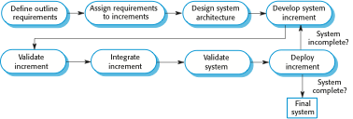

Slide 56
Incremental delivery advantages
Customer value can be delivered with each increment so system functionality is available earlier.
Early increments act as a prototype to help elicit requirements for later increments.
Lower risk of overall project failure.
The highest priority system services tend to receive the most testing.

Slide 57
Boehm’s spiral model
Process is represented as a spiral rather than as a sequence of activities with backtracking.
Each loop in the spiral represents a phase in the process. Thus, the innermost loop might be concerned with system feasibility, the next loop with requirements definition, the next loop with system design, and so on.
No fixed phases such as specification or design - loops in the spiral are chosen depending on what is required.
Risks are explicitly assessed and resolved throughout the process.

Slide 58
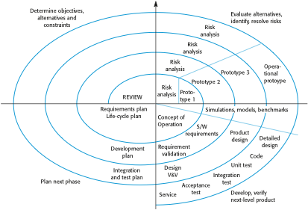
Boehm’s spiral model of the software process

Slide 59
Spiral model sectors
Each loop in the spiral is split into four sectors:
1. Objective setting Specific objectives for that phase of the project are defined. Constraints on the process and the product are identified and a detailed management plan is drawn up. Project risks are identified. Alternative strategies, depending on these risks, may be planned.
2. Risk assessment and reduction For each of the identified project risks, a detailed analysis is carried out. Steps are taken to reduce the risk. For example, if there is a risk that the requirements are inappropriate, a prototype system may be developed.

Slide 60
Spiral model sectors
3.Development and validation
A development model for the system is chosen which can be any of the generic models.
4.Planning
The project is reviewed and a decision made whether to continue with a further loop of the spiral. If it is decided to continue, plans are drawn up for the next phase of the project.

